Slide 1

Using the
Templates
On slide 3 you will find the template for promoting your role at our event. Examples are at the back of this deck.
Update the information (Headshot) – see next screen for detailed instructions on how to do this.
Print the appropriate slides as JPGs which will fit neatly into your social media platform!
Open the “Kit” (MS Word document) that fits your situation to source suggested pre-, during, and post- conference social media posts.

Slide 2
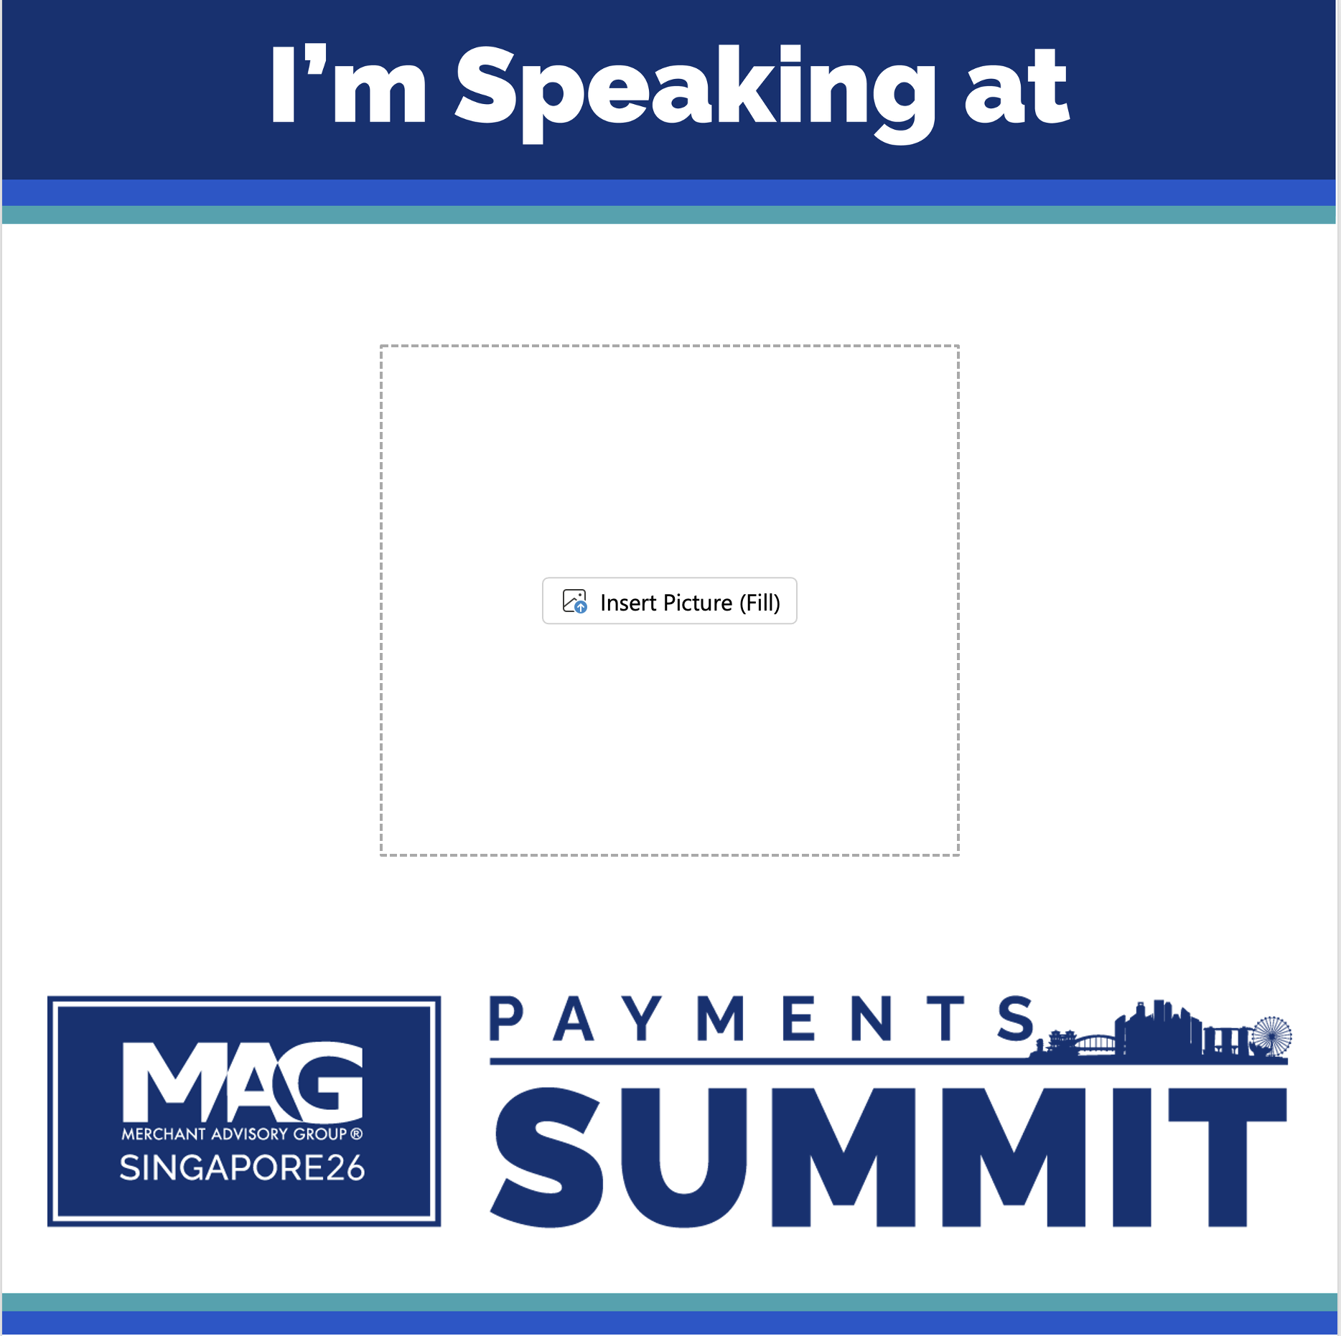
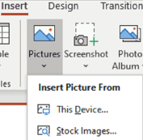
Insert Picture in
PowerPoint
Click the placeholder.
On the insert tab, in the Images group, click “Pictures” and then click “This Device.”
In the dialog box that opens, navigate to the photo you want to insert and click “Insert.”
    For best results crop or resize your photo or logo before adding it to the template.

Slide 4
Speaker Social Share Kit
GENERIC STATEMENT (USE UNTIL 12 OCTOBER):
Option 1: I am excited to be part of the MAG Payments Summit-Singapore 26 agenda this coming October for [INSERT SESSION TITLE]. Register for the #MAGPaymentsAPAC Summit today and share the excitement centered around this event! https://www.merchantadvisorygroup.org/conferences/mag-payments-summit-singapore-26
GENERIC STATEMENT (USE UNTIL 12 OCTOBER):
Option 2: I am privileged to be a speaker at the MAG Payments Summit-Singapore 26, which invites industry experts to discuss various topics including fraud, payments processing, alternative payments, and authentication. I strongly recommend securing your spot and registering today! #MAGPaymentsAPAC https://www.merchantadvisorygroup.org/conferences/mag-payments-summit-singapore-26
USE UNTIL 19 OCTOBER:
Option 3: The MAG Payments Summit-Singapore 26 aims to cultivate enduring partnerships and provide valuable insights from payments industry experts. I am thrilled to take the stage and share my perspective during the [INSERT SESSION TITLE]. I look forward to seeing you there! #MAGPaymentsAPAC https://www.merchantadvisorygroup.org/conferences/mag-payments-summit-singapore-26
USE WHEN REGISTRATION IS CLOSED (13 OCTOBER- 19 OCTOBER):
Option 4: The MAG Payments Summit- Singapore 26 is [less than a week away/starts tomorrow]! I am excited to join payments experts to discuss industry challenges and opportunities for both business and tech-minded individuals. I hope to see you there! #MAGPaymentsAPAC
IMPORTANT INFORMATION:
HASHTAG: #MAGPaymentsAPAC #MAGPaymentsSummit
IMPORTANT LINKS:
https://www.merchantadvisorygroup.org/conferences/mag-payments-summit-singapore-26
www.linkedin.com/company/merchant-advisory-group/

Slide 5


