Slide 1

Using the
Templates
On slide 3 you will find the template for promoting your role at our event. Examples are at the back of this deck.
Update the information (Headshot) – see next screen for detailed instructions on how to do this.
Print the appropriate slides as JPGs which will fit neatly into your social media platform!
Open the “Kit” (MS Word document) that fits your situation to source suggested pre-, during, and post- conference social media posts.

Slide 2
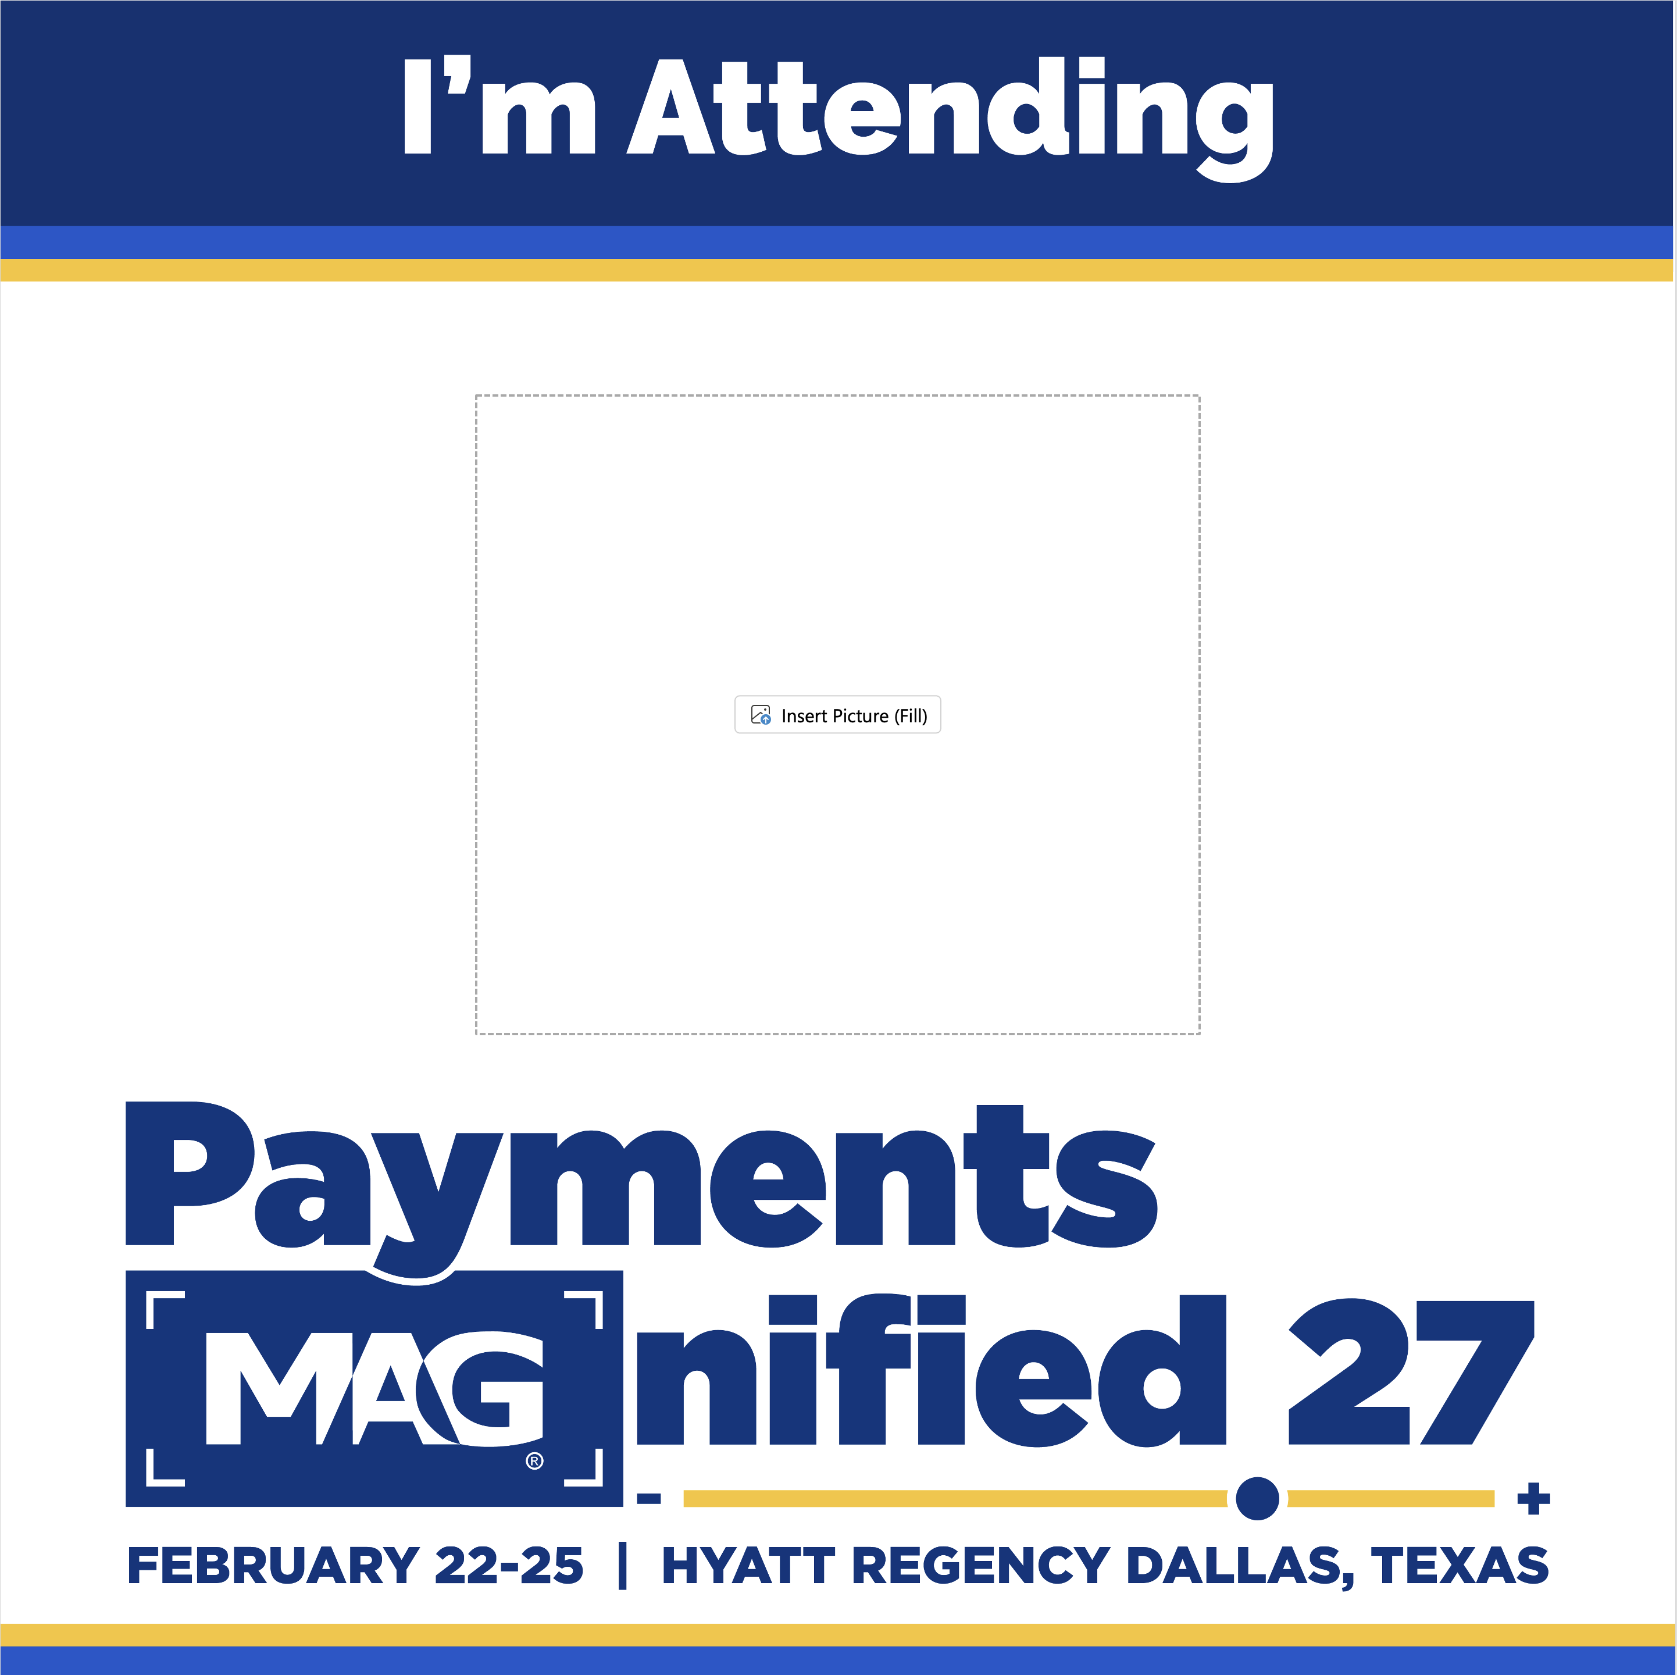
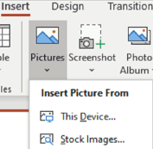
Insert Picture in
PowerPoint
Click the placeholder.
On the insert tab, in the Images group, click “Pictures” and then click “This Device.”
In the dialog box that opens, navigate to the photo you want to insert and click “Insert.”
    For best results crop or resize your photo or logo before adding it to the template.

Slide 4
Attendee Social Share Kit
GENERIC STATEMENT (USE UNTIL FEBRUARY 9):
Option 1: I am excited to be attending Payments MAGnified 27 happening, February 22-25, 2027. Register for #PaymentsMAGnfied today and share the excitement centered around this event!
https://www.merchantadvisorygroup.org/conferences/payments-magnified-27?utm_source=LinkedIn&utm_medium=Organic&utm_campaign=PM27
GENERIC STATEMENT (USE UNTIL FEBRUARY 9):
Option 2: I am privileged to be attending Payments MAGnified 27, which invites industry experts to discuss various topics including fraud, payments processing, alternative payments, and authentication. I strongly recommend securing your spot and registering today! #PaymentsMAGnified
https://www.merchantadvisorygroup.org/conferences/payments-magnified-27?utm_source=LinkedIn&utm_medium=Organic&utm_campaign=PM27
USE UNTIL FEBRUARY 14:
Option 3: Payments MAGnified 27 aims to cultivate enduring partnerships and provide valuable insights from payments industry experts. I look forward to seeing you there! #PaymentsMAGnified
https://www.merchantadvisorygroup.org/conferences/payments-magnified-27?utm_source=LinkedIn&utm_medium=Organic&utm_campaign=PM27
USE WHEN REGISTRATION IS CLOSED (FEBRUARY 14):
Option 4: The 2027 #PaymentsMAGnfied is [less than a week away/starts tomorrow]! I am excited to join payments experts to discuss industry challenges and opportunities for both business and tech-minded individuals. I hope to see you there!
IMPORTANT INFORMATION:
HASHTAG: #PaymentsMAGnified
IMPORTANT LINKS:
https://www.merchantadvisorygroup.org/conferences/payments-magnified-27?utm_source=LinkedIn&utm_medium=Organic&utm_campaign=PM27
www.linkedin.com/company/merchant-advisory-group/

Slide 5


